Slide 1
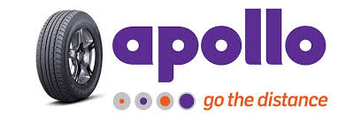
Analysis on Apollo tyres ltd.

Slide 2
About Apollo tyres ltd
World's 17th biggest tyre manufacturer, with annual consolidated revenues of Rs 117.1 billion (US$1.8 billion) in March 2016
Founded in 1972
First plant was commissioned in Perambra, Thrissur, Kerala, India
Company now has four manufacturing units in India, and 1 in Netherlands
A network of nearly 5,000 dealerships in India, of which over 2,500 are exclusive outlets
Gets 69% of its revenues from India, 26% from Europe and 5% from other geographies
Apollo announced its entry into the two-wheeler tyre segment with contract manufacturing in March 2016

Slide 3
History:
Company was conceived and promoted by Mathew T Marattukalam, Bharat Steel Tubes, Ltd. Raunaq International Pvt. Ltd., Raunaq & Co. Pvt. Ltd., Raunaq Singh and Jacob Thomas.
1st plant established at Perambra, Kerala, India
2nd plant at Limda, Gujarat, India
Acquired Premier Tyres Limited- PTL. It is the 3rd plant at Kalamassery, Kerala, India
Expanded operations outside India by acquiring Dunlop's Africa operations
1976
1977
1991
1995
2006

Slide 4
History:
A new plant at Chennai Tamil Nadu, India
Apollo Tyres acquired the Netherlands-based tyre maker Vredestein Banden B.V. (VBBV) for an undisclosed sum
Disposed of the Dunlop brand in Africa along with most of the South African operation in a sale to Sumitomo Rubber Industries of Japan.
Apollo has bought Germany’s Reifencom for €45.6 million
2008
2009
2013
2015

Slide 5
Management discussion and analysis
As on 31st march 2016, Company has 41 subsidiaries including step subsidiary, 1 joint venture and 1 associate
Fiscal Year (FY) 2015-16 was a year of multiple emotions-cautious optimism, uncertainty and pessimism, depending on which part of the globe you looked at
Apollo Tyres continued to focus on consolidating its leadership position in-key markets
By expanding market share through new products, focusing on enhancing its retail presence and becoming a full range player in India with the launch of the two-wheelers tyre range
Company acquired the Germany-based tyre distributor, Reifencom GmbH to support its plan of ramping up our retail network in Europe

Slide 6
industry overview
Demand from CV industry accounts for 60% of the tyre Industry demand, and is based on the growth of the economy
Major players are MRF, JK Tyres, and Apollo Tyres & CEAT, which account for 63 per cent of the organized tyre market. The other key players include Modi Rubber, Kesoram Industries and Goodyear India, with 11 per cent, 7 per cent and 6 per cent share respectively
With growth slowing and anticipating the shift towards radialisation manufacturers adding capacity of 6 mn TBR (truck and bus radial), utilisation rates could be lower in the next 2-3 years
Also, over the past two years the manufacturers have been in a capex phase, companies tried to add radial capacity due to the sudden shift in demand towards radial tyres and hence the industry managed good pricing discipline
It will be interesting to see if this discipline continues with lower utilisations.
On geographical basis, total income from Asia Pacific, Middle East and Africa (APMEA) operations grew by 5.0% YoY at Rs.25.5 bn led by India business. The volume in India business grew by 13% YoY led by strong growth of 32% YoY and 16% YoY in Farm tyre and Passenger Car segment respectively
The management has stated that the demand outlook has improved significantly for both, domestic as well as European operations

Slide 7
Industry Overview
Overall Indian Auto industry witnessed muted growth in FY16 at 3.8% as compared to 7.2% in FY15
Production levels in the Medium and Heavy Commercial Vehicles (M&HCV) segment declined by 3%, while the Light Truck segment was down by 8.6% in volume terms
The Euro Area grew by 1.6%, while the European Union (EU) posted a rate of 1.9%, as estimated by Eurostat
The replacement market continues to support the tyre makers as it accounts for 72% of M&HCV and 57% of PV segments
Export obligation fulfilment period was reduced to 6 months from 18 months
Government restricted the imports of natural rubber only to Chennai and Nhava Sheva seaports, thus imposing extra logistics and handling costs

Slide 8
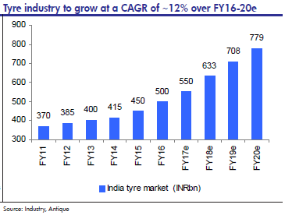
Industry Overview
As can be seen that the Industry grew at remarkable 12% CAGR in India since 2011 as compared to Global 4-5% CAGR. It is expected that global sector will grow at 6.8 % till 2022 where as it is predicted that the Indian sector will grow at 9%. The global industry is also taking a big hit because for rising prices in the global market for raw material which reflects the predictions.

Slide 9
SWOT analysis

Slide 10
SWOT ANALYSIS
Strengths
S
Apollo Tyres has the advantage of a diversified market base across geographies
An entry into the two wheeler tyre
segment, the Company is now a full range tyre player in India
Apollo Tyres enjoys an extensive distribution
network
In Europe, the Company’s brand ‘Vredestein’
has an established presence
Company has acquired reifencom
GmbH, one of the largest tyre distributors
in Germany
modern Research &
Development (R&D) facilities for PV and CV
tyres

Slide 11
SWOT ANALYSIS
Weaknesses
W
Company is currently not present in
the European OEM market for regular
passenger car tyres
needs to establish a larger presence in new growing geographies to reach economic sized operations
unable to
effectively block low quality low cost
Chinese tyres through Government
intervention

Slide 12
SWOT ANALYSIS
Opportunities
O
In the truck-bus radial segment has a healthy lead over its competition
in terms of capacity and market share
Positioned to grow in the European
market due to a new cost competitive
manufacturing facility
PV tyres sold in Europe could develop into a sizable market for the same
looking at introducing
products and make an entry into the
European Truck and Bus segments
Increasing its
focus towards new geographies like the
Middle East and South East Asia
Can convert excess bias
capacity into more profitable industrial
tyres capacity

Slide 13
SWOT ANALYSIS
Threats
T
Increased competition from global players
like Michelin and Bridgestone in India.
Economic downturn or slowdown in the key markets – Europe and India
Increased competition of truck radial
imports from China resulting in a decline in volumes
Threat of raw material price
volatility, translating into pressured
margins
Weak Indian currency resulting in pressure
on margins
Growing influence of budget tyres, mainly
tier 2 and 3 brands

Slide 14
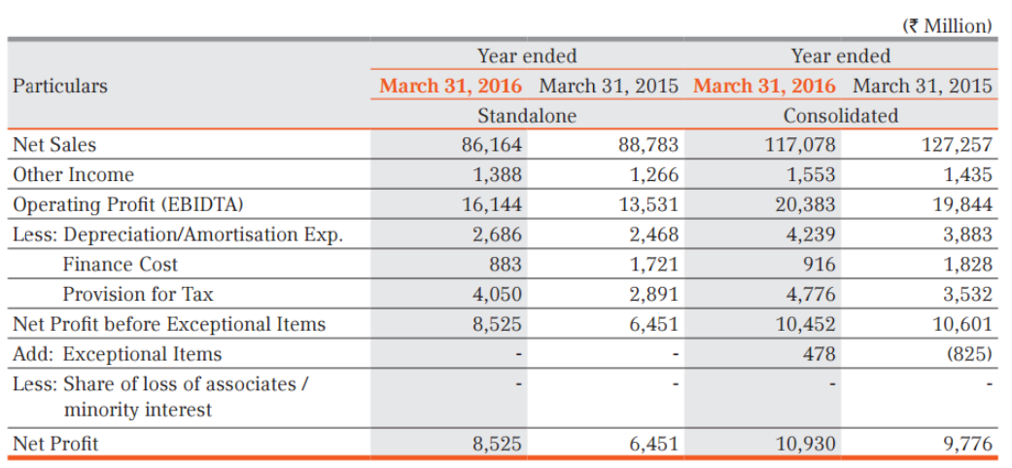
Balance Sheet Analysis
Summary

Slide 15
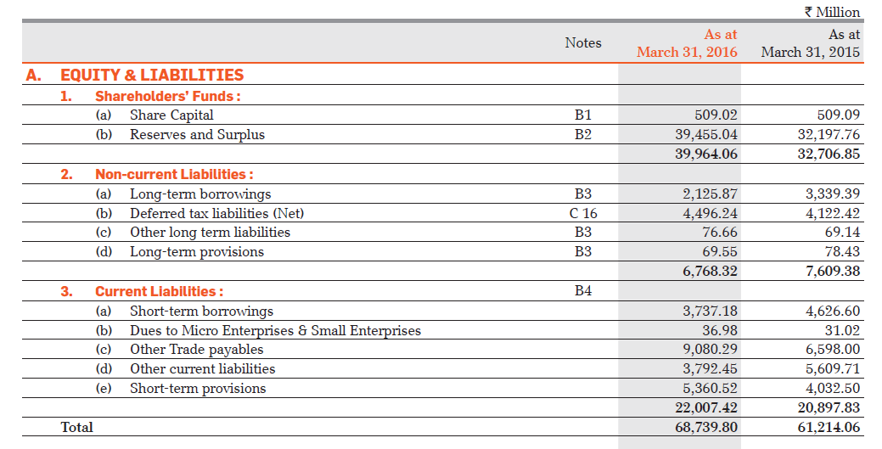
Equity & Liabilities

Slide 16
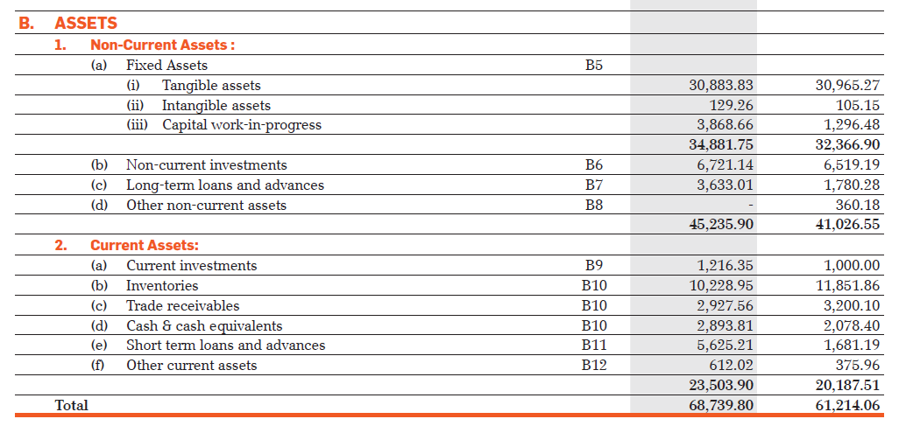
Assets

Slide 17
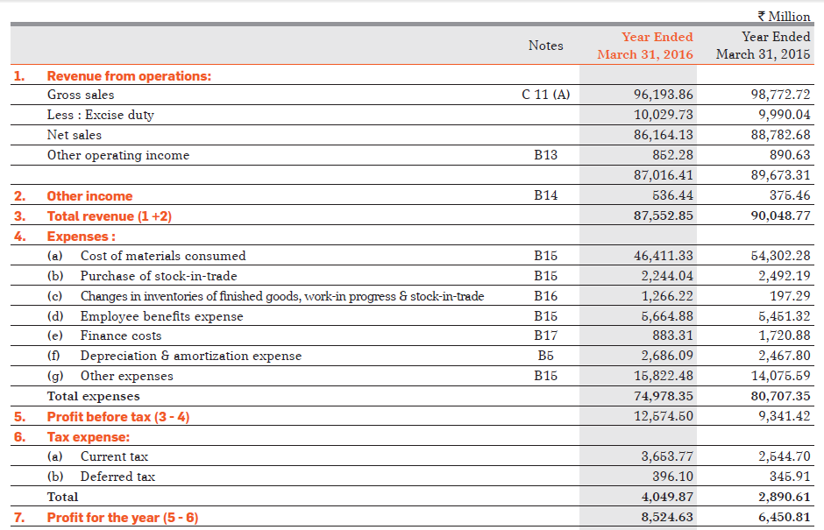
Profit & Loss Account

Slide 18
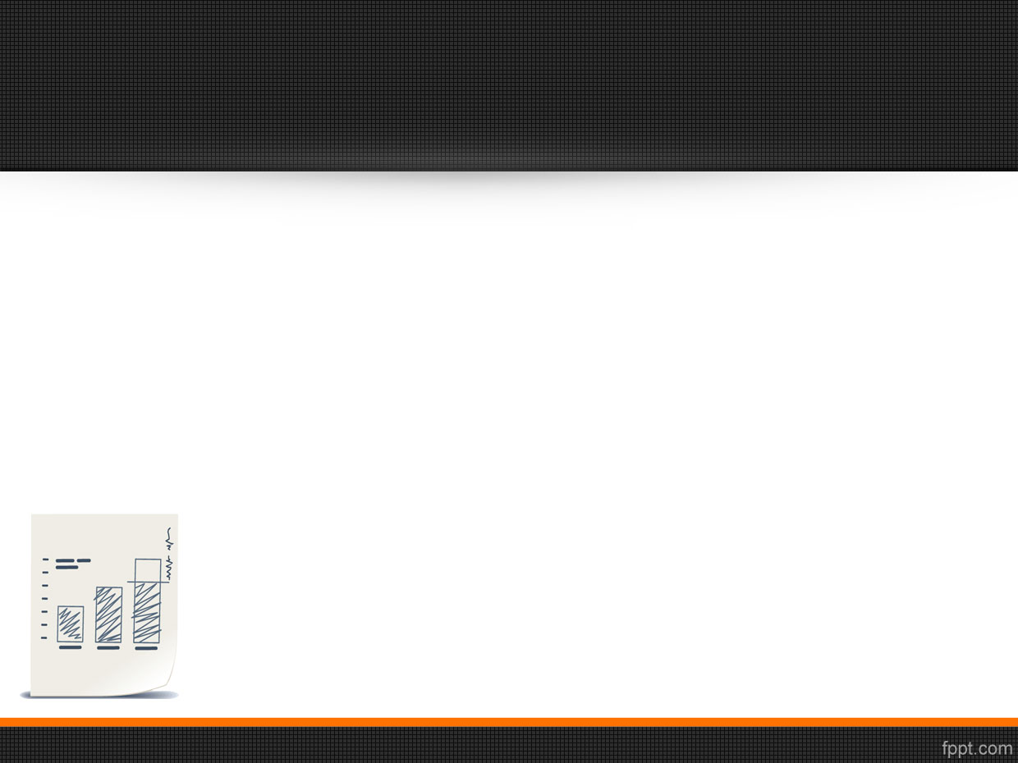
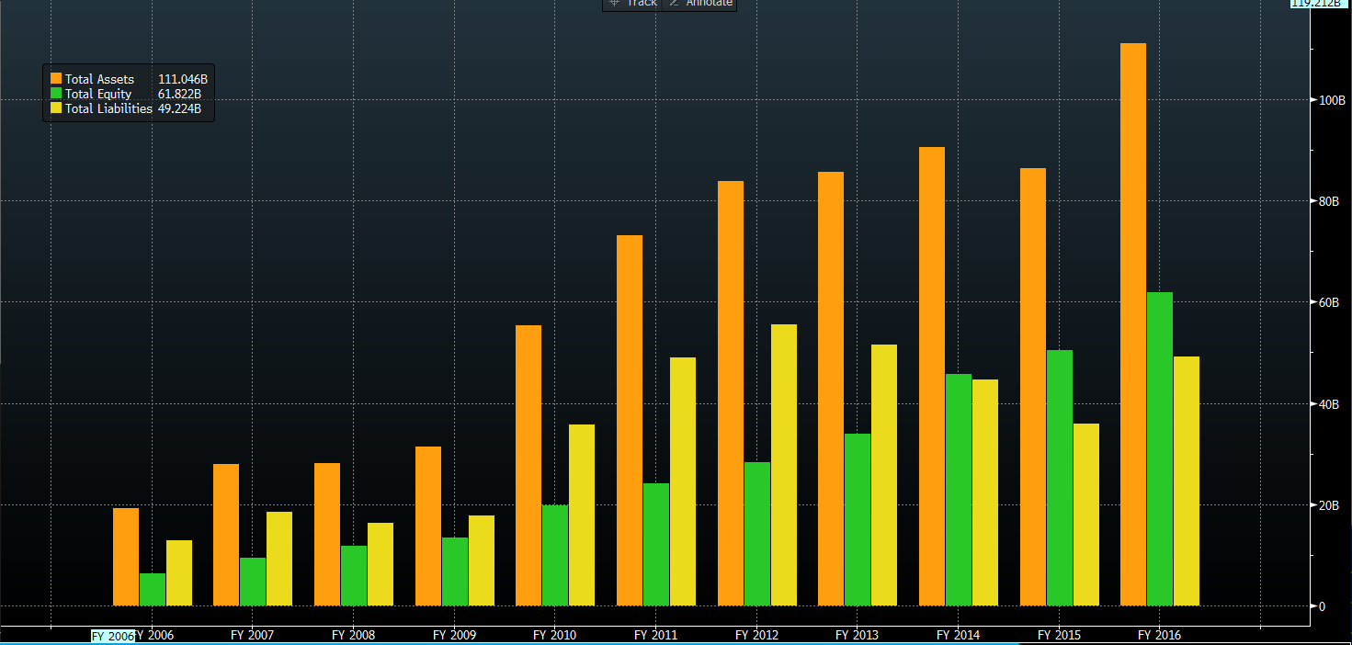
Asset Equity Liability Comparison

Slide 19
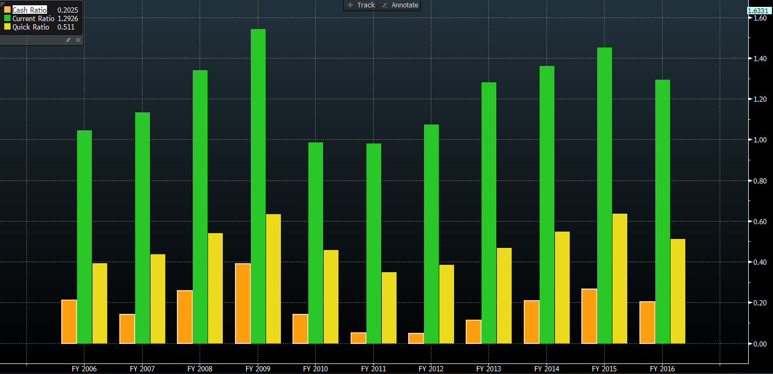
Liquidity Ratios

Slide 20
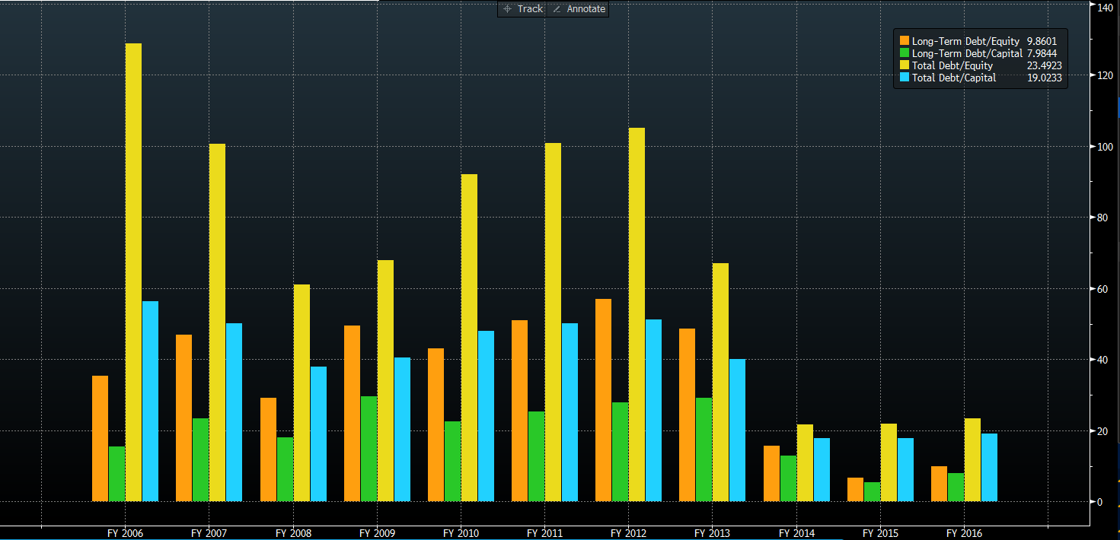
Debt ratio

Slide 21
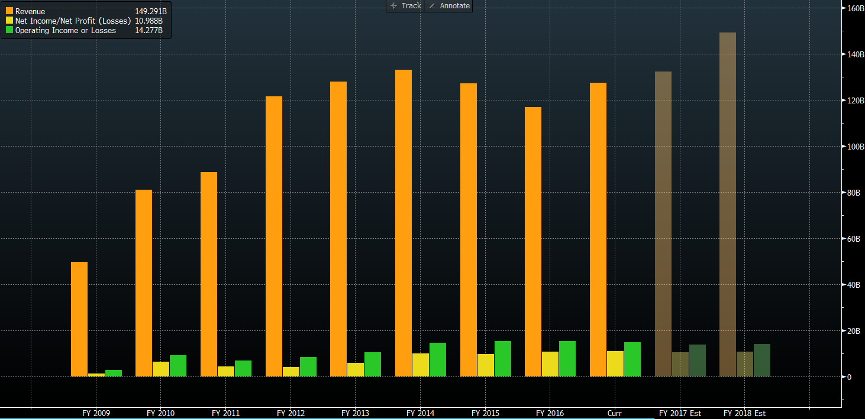
Revenue profit and Operating profit

Slide 22
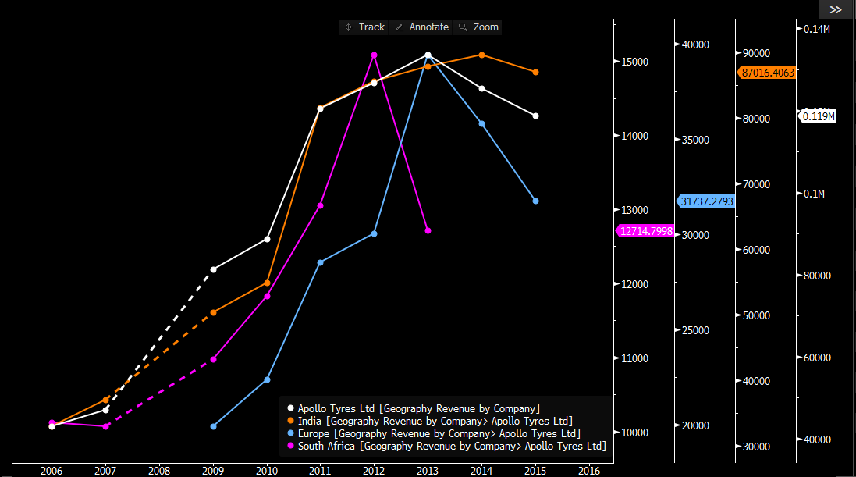
Sale from different regions

Slide 23
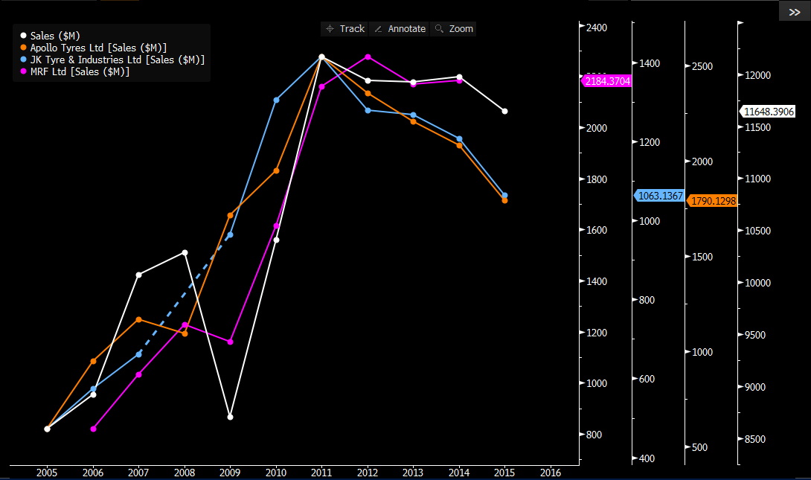
Sale from Indian region

Slide 24
Liquidity & Credit Analysis
Current Ratio
Higher current ratio implies healthier short term liquidity comfort level. A current ratio below 1 indicates that the company may not be able to meet its obligations in the short run. However, it is not always a matter of worry if this ratio temporarily falls below 1 as many times companies squeeze out short term cash sources to achieve a capital intensive plan with a longer term outlook. Apollo’s average current ratio over the last 5 financial years has been 1.23 times which indicates that the Company is comfortably placed to pay for its short term obligations.
Long Term Debt to Equity Ratio
Companies operating with high long term debt to equity on their balance sheets are vulnerable to economic cycles. In times of slowdown in economy, companies with high levels of debt find it increasingly difficult to service the interest on their borrowings as profit margins decline. We believe that long term debt to equity ratio higher than 0.6 – 0.8 could affect the business of a company and its results of operations.
Apollo’s average long term debt to equity ratio over the last 5 financial years has been 0.36 times which indicates that the Company operates with low level of debt.
Interest Coverage ratio
Interest coverage ratio indicates the comfort with which the company may be able to service the interest expense (i.e. finance charges) on its outstanding debt. Higher interest coverage ratio indicates that the company can easily meet the interest expense pertaining to its debt obligations. In our view, interest coverage ratio of below 1.5 should raise doubts about the company’s ability to meet the expenses on its borrowings. Interest coverage ratio below 1 indicates that the company is just not generating enough to service its debt obligations.
Apollo’s average interest coverage ratio over the last 5 financial years has been 6.23 times which indicates that the Company can meet its debt obligations without any difficulty.

Slide 25
Dividend history & Ownership Pattern
The Company has maintained an average dividend yield of 0.66 % over the last 5 financial years.
In its latest stock exchange filing dated 31 March 2016, Apollo reported a promoter holding of 44.15 %. Large promoter holding indicates conviction and sincerity of the promoters. We believe that a greater than 35 % promoter holding offers safety to the retail investors.
At the same time, institutional holding in the Company stood at 42.63 % (FII+DII). Large institutional holding indicates the confidence of seasoned investors. At the same time, it can also lead to high volatility in the stock price as institutions buy and sell larger stakes than retail participants.

Slide 26
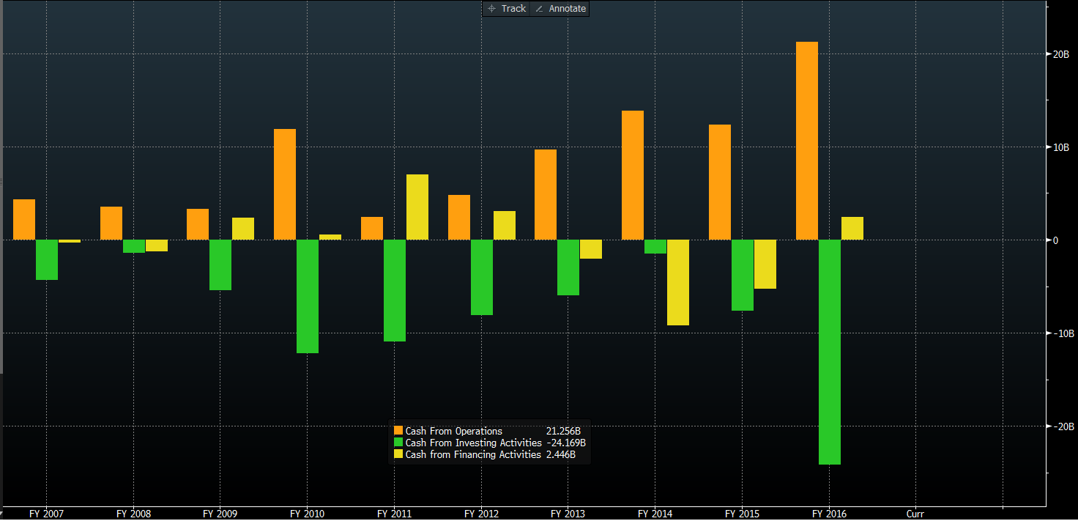
Cash flow graph

Slide 27
Cash flow statement
CASH FROM OPERATING ACTIVITIES:
Cash from operating activities have seen the increase by 88.41% from FY15 to FY16. The amount of increase in the inflow through operating activities is quite huge.
CASH FROM INVESTING ACTIVITIES:
The amount of cash which have been invested in this year has been 3 times of what it was in the previous year. The company in November 2016 decided to set up a manufacturing plant with investment of ₹525 cr.
CASH FROM FINANCING ACTIVITIES:
Now financing activities takes into account the interest payments, loans taken, dividends paid. This year the company has seen Cash-In which means the company might have taken loans for its financing.

Slide 28
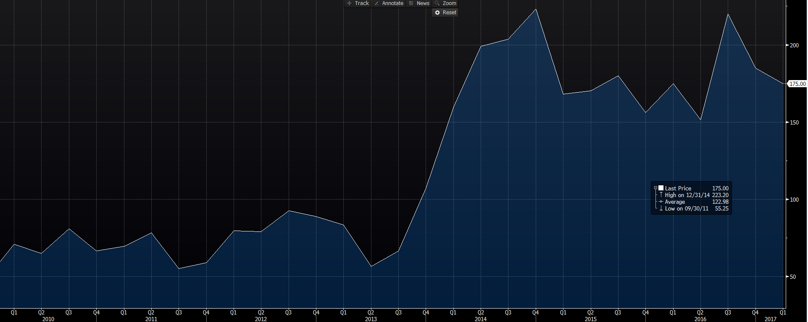
Share Price Performance

Slide 29
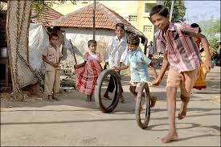
How are we against our peers….!!!

Slide 30
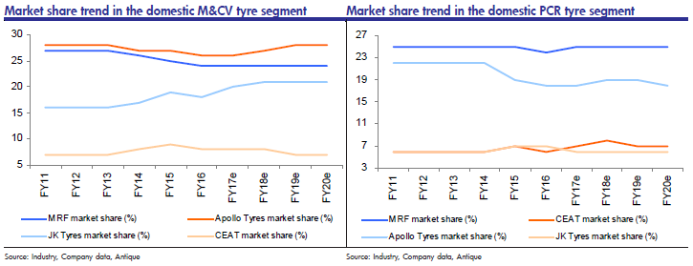
Market Trends Among the competitors

Slide 31
Competition

Slide 32
Horizontal analysis of Apollo tyres ltd. , Mrf tyres ltd & ceat tyres ltd.
Comparing the percentage change in ratios of current year with previous year for Apollo tyres ltd and its competitors MRF tyres ltd. & CEAT tyres ltd.
Apollo tyres ltd.
MRF tyres ltd.
CEAT tyres ltd.
Revenue from operations
-7.99%
54.01%
-1.28%
Purchase of Stock in trade
3.20%
-35.93%
20.4%
Finance cost
-49.9%
48.31%
-31.18%

Slide 33
Apollo tyres ltd.
MRF tyres ltd.
CEAT tyres ltd.
Profit after tax
11.80%
160.48%
40.76%
Other Expenses
4.10%
64.56%
8.64%
Current Liabilities
35.98%
10.34%
-21.30%
Current Assets
22.50%
12.60%
-17.55%
Long Term Borrowing
82.53%
23.88%
66.44%
Fixed Assets
18.21%
39.47%
34.35%

Slide 34
DuPont Analysis
“DuPont Financial Analysis Model is a rather straightforward method for assessing the factors that influence a firm’s financial performance.”

Slide 35
DuPont System – What is It?
The system identifies profitability as being impacted by three different levers:
Earnings & efficiency in earnings
Ability of your assets to be turned into profits
Financial leverage
Earnings
Turnings
Leverage

Slide 36
DuPont System
Earnings/Efficiency
Profit Margin
Return On Assets (less interest adj.)
Income Stream
X
=
Asset Turnover
X
=
Return On Equity
Turnings/Asset Use
Financial Structure
Investment Stream
Leverage

Slide 37
DuPont analysis of Apollo tyres ltd. & MRF tyres ltd.
ROE
(17.68%)
Return on net assets
Profit Margin
(13.16%)
Asset Turnover
(1.55)
Financial Leverage
(0.8587)
ROE
(34.25%)
Return on net assets
Profit Margin
(17.64%)
Asset Turnover
(2.03)
Financial Leverage
(0.9514)
Apollo Tyres ltd
MRF Tyres ltd.

Slide 38
Correlation between Apollo tyres shares with other competitors and nifty
Taken historical prices of Nifty, Apollo tyres, MRF tyres, JK tyres
Found the correlation between each.
Correlation : correlation values
Apollo tyres - Nifty | 0.5202 (52.02%)
Apollo tyres – MRF tyres | 0.7317(73.17%)
Apollo tyres – JK Tyres | 0.7838(78.38%)

Slide 39
Apollo tyres VS j.k. tyres
Earning Per Share
Rs. 21.50
Rs. 14.50
Dividend Per Share
Rs. 2.00
Rs. 1.5

Slide 40
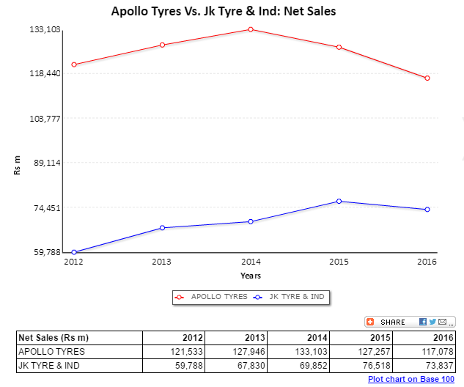
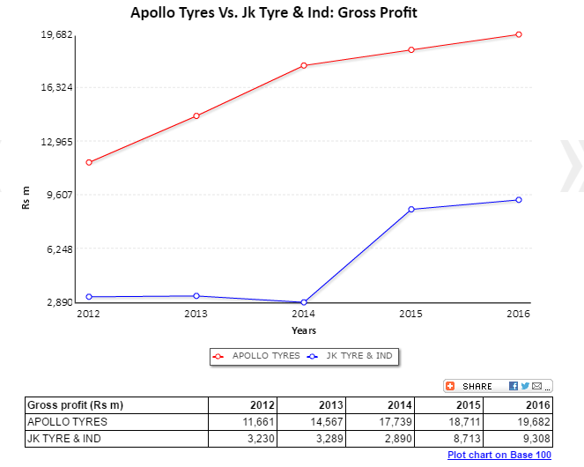
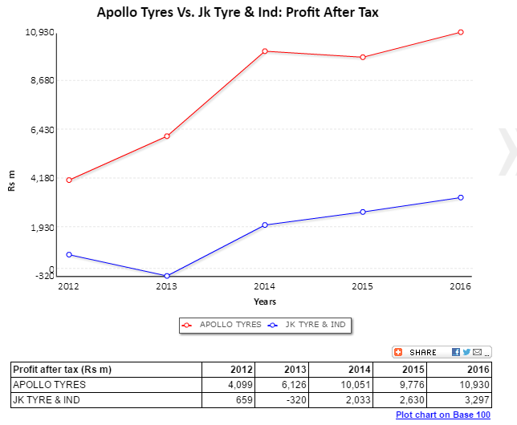

Slide 41
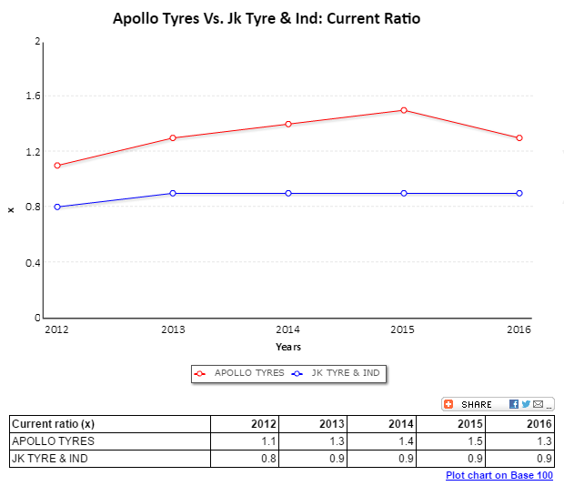
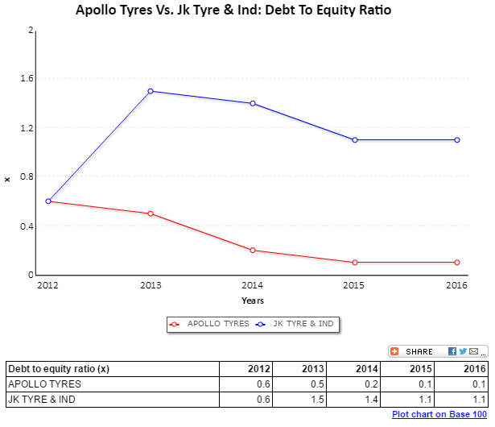
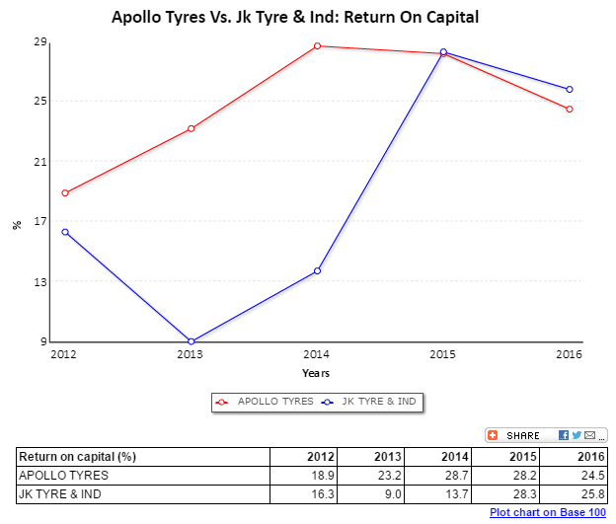

Slide 42
Outlook of stock
As per Bloomberg source and independent Research houses, 65% predict the BUY option and 25% on HOLD
Company Name | Rating | Impact on Company
Apollo tyres ltd. | BUY | POSITIVE
*At your risk

Slide 43
Thank you

